Slide 1

CSE-4078 Mobile Application Development
Lecture 12 and 13
Sara Masood

Slide 2
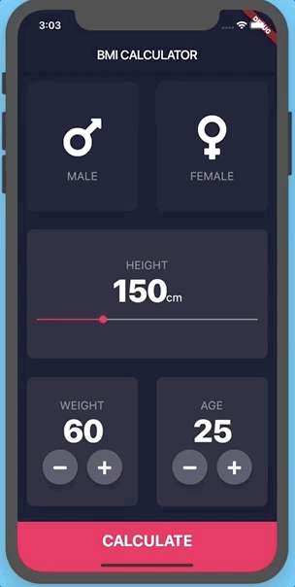
App of the week - Continued

Slide 3
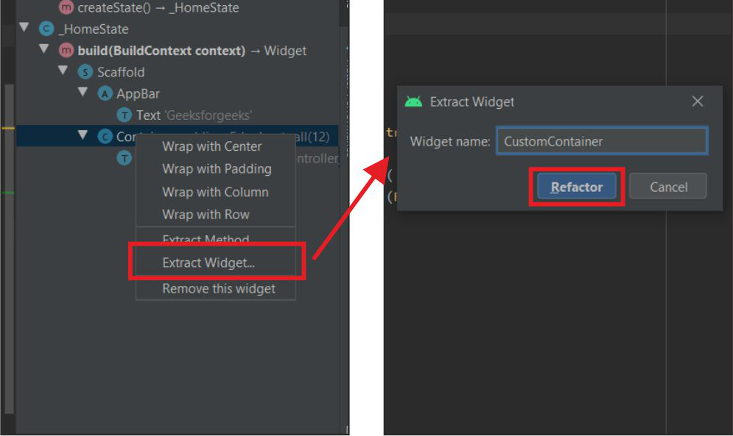
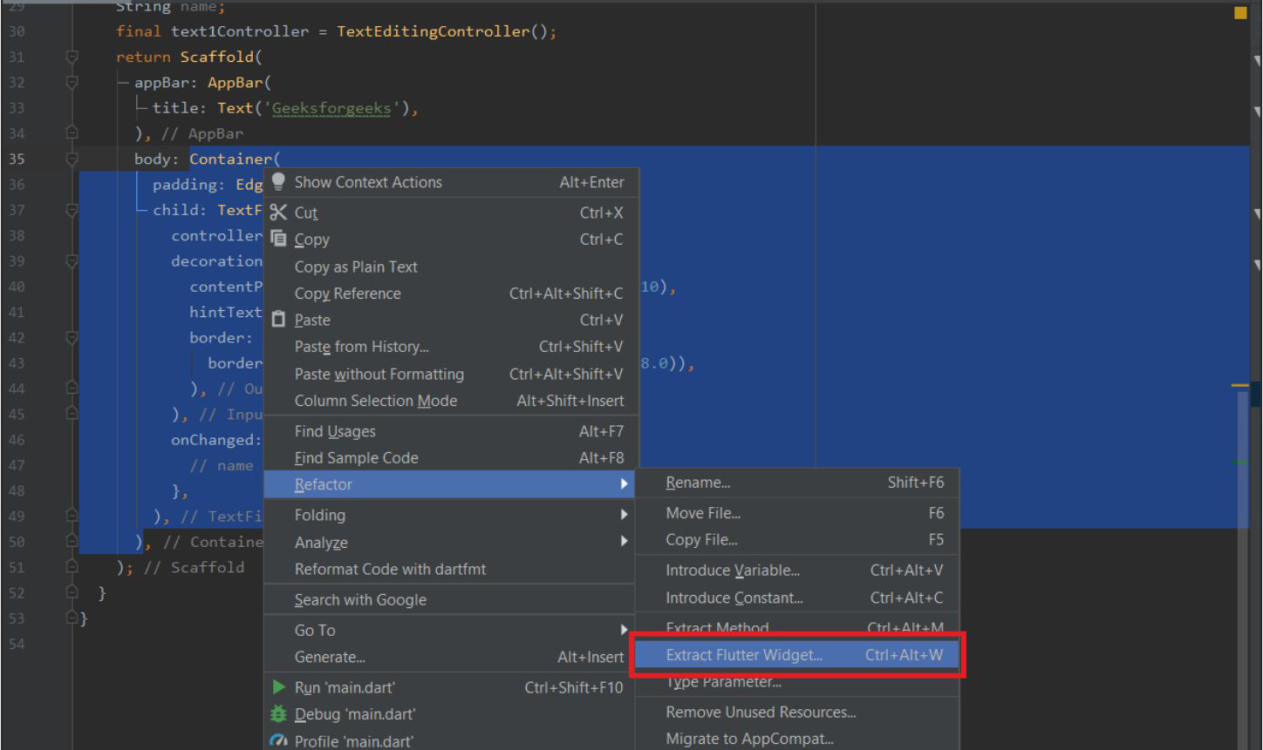
Flutter – Splitting App into Widgets
Splitting an app into widgets refers to the breaking up of large widgets into smaller, more manageable widgets which can be inferred as smaller chunks of codes.

Slide 4
GestureDetector class
A widget that detects gestures.
Attempts to recognize gestures that correspond to its non-null callbacks.
GestureDetector class - widgets library - Dart API (flutter.dev)

Slide 5
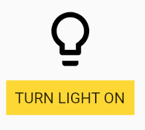
GestureDetector class
GestureDetector(
onTap: () {
setState(() {
_lightIsOn = !_lightIsOn;
});
},
child: Container(
color: Colors.yellow.shade600,
padding: const EdgeInsets.all(8),
child: Text(_lightIsOn ? 'TURN LIGHT OFF' : 'TURN LIGHT ON'),),

Slide 6
Ternary Operator in Dart and Flutter
Syntax
condition ? exprIfTrue : exprIfFalse
Example
String message(bool isValid) {
return isValid ? 'This is valid' : 'This is not valid';
}

Slide 7
Enums In Dart and Flutter
In Dart, Enums are a special kind of class used to represent a fixed number of constant values
enum Result {
LoginSuccess,
LoginFail}
void main(){
var result = Result.LoginSuccess;
switch(result){
case Result.LoginSuccess:
print("Login successfully");
break;
case Result.LoginFail:
print("Mobile or email invalid");
break;}}

Slide 8
Slider class
A Material Design slider.
Used to select from a range of values.

Slide 9
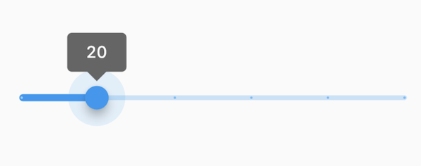
Slider class - Example
double _currentSliderValue = 20;
Slider(
value: _currentSliderValue,
min: 0,
max: 100,
divisions: 5,
label: _currentSliderValue.round().toString(),
onChanged: (double value) {
setState(() {
_currentSliderValue = value;
});},);}

Slide 10
SliderTheme and SliderThemeData class
Holds the color, shape, and typography values for a material design slider theme.
SliderThemeData class - material library - Dart API (flutter.dev)

